Slide 1
Care Coordination Series Part 1: Hospital and Nursing Home Settings
Presented By:
Angie Scally, RN | Director of Clinical Coordination | CarDon & Associates
Ann Smith, MHL, RN, ACMA | Director of IP and OP Care | Union Health System

Slide 2
Webinar: Agenda and Chat Rules
To ensure maximum sound quality, participant lines have been muted during the presentation; however, we welcome questions and comments via the chat box on the right-hand side of your screen
During the Q&A portion of the presentation, we will unmute your lines.
To submit questions or comments:
Use the chat box or,
Raise your hand to verbally ask your question
Opening Remarks
Housekeeping
Presentation
Q&A
Closing Remarks

Slide 3
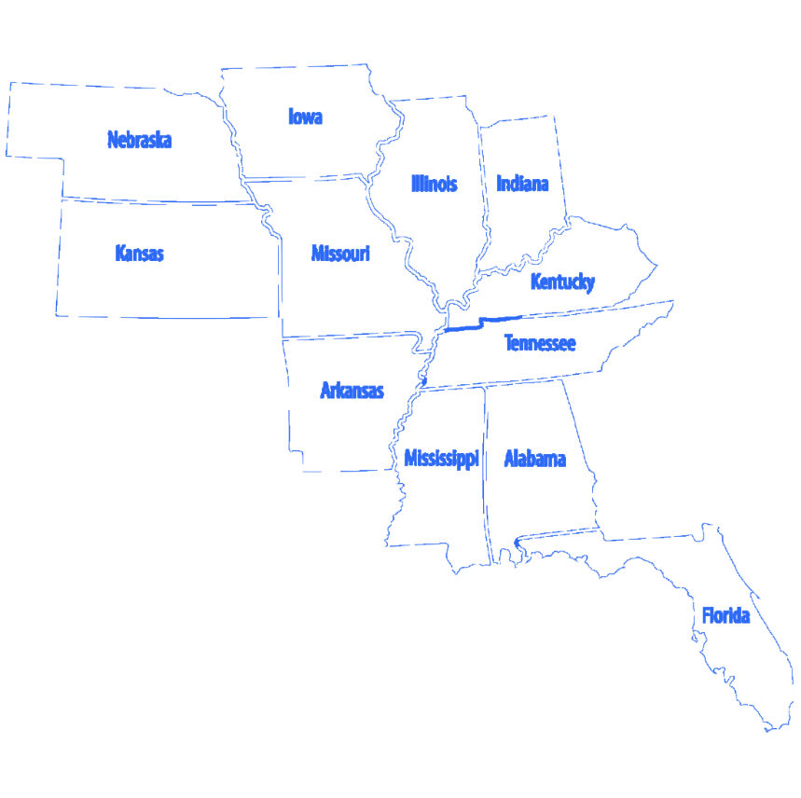
Qsource has more than 45 years of experience working with with healthcare providers, Medicare and Medicaid. Currently operate in 11 states overseeing ESRD, EQRO and QIO activities. Serves as the Medicare Quality Innovation Network-Quality Improvement Organization (QIN-QIO) for Indiana.

Slide 4
Polling Question
In what setting do you work in?
Ambulatory Care
Community Based
Home Health
Government
Pharmacy
Long-term Care
Hospital
Other

Slide 5
Polling Question
Polling Question
What is your role in your organization?
Health Educator
Heathcare Provider
Long-term Care Clinical Staff
Long-term Care Administrator
Patient Advocate
Quality Improvement Specialist
Nurse
Other

Slide 6
Telehealth
Angie Scally
RN, BSN

Slide 7
Telehealth in a SNF setting?
Telehealth provides virtual urgent and emergent care in post-acute care settings, preventing unnecessary trips to the hospital. Residents are quickly connected to physician specializing in acute-level care. Through accessible, integrated technology, nurses are quickly connected to board certified physicians with the simple touch of a button.

Slide 8
Why Use Telehealth?

Slide 9
Benefits of Telehealth
After Hours MD coverage
Video Consults via iPad
Detailed Physician Notes/Orders
Care Coordination with Primary Physician
Reduced Readmissions to the Hospital
EMR integration
Resident satisfaction
Comforts family
Staff satisfaction
Provider Calls ED to give report

Slide 10
After Hours MD Coverage
Coverage:
Mon-Thurs
5pm-8am
Fri-Mon
5pm-8am
Coverage all evening, all night and all weekend and on holidays @ the click of a button.

Slide 11
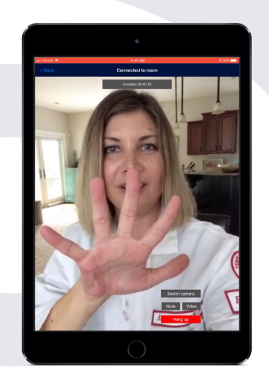
Video Consults Via IPAD
Face to Face Physician Interaction
Guided Physician to Nurse Assessment
Physician/Patient Interaction at Bedside
Provider awake and ready for calls

Slide 12
Detailed Physician Notes and Orders
Detailed Notes Integrated into Matrix
Medical Director Notification
Facility Leadership Notification

Slide 13
CarDon Utilization-2023

Slide 14
Challenges To Tackle
Staff turn over
Medical Director Buy -In
Leadership Buy-In
Logins-Passwords
Ongoing training of new staff

Slide 15
What have we learned:
1. Roll out date and time is important
2. Discuss the why behind use with all staff
3. Leadership present during all trainings are important
4. Ongoing trainings required for new hires
5. Provide a standardized letter to all families regarding the program
6. Meet with Medical Directors and explain the why
7. Gather regular feedback from staff- stay on top of barriers and challenges

Slide 16
Feedback
Nurses love having access to a provider by video with-in 2 minutes of a change in condition
Nurses are learning better assessment skills
Residents feel comforted
Decreases nurse anxiety
Decreases family and resident/anxiety
Medical Directors get to rest during the night- good reporting and communication

Slide 17
Things to consider when choosing a telehealth provider
1. Coverage Times
2. Will they use your company protocols
3. Do they help provide training to community staff
4. Do they have good reporting
5. Do they integrate into your EMR
6. Do they provide a good point of contact to discuss challenges and opportunity
7. Who is providing the telehealth coverage
8. Will providers talk with families
9. Will they call the ER and give report
10. How quickly are provider notes entered into EMR

Slide 18
Thank You!
Angie Scally RN, BSN Director of Clinical Coordination
ascally@cardon.us

Slide 19
Best Practices and Challenges
Presented By: Ann Smith, MHI, RN, ACMA

Slide 20
Union Hospital Best Practices and Challenges
Wabash Valley Care Coalition Meetings
Affiliate agreements with Skilled Facilities
Monthly Meetings, Goals and Data Driven (Olio), Union Resources at the Facilities
OP Care Management Team
AWV’s CCM, TCM
Hospital D/C
F/U’s, Care Plans, Virtual Nursing coming soon

Slide 21
Q&A Session with Today’s Panelists

Slide 22
Your Feedback is Valuable
Polling Question
On a scale of 1 to 5 where 5 represents “Very Satisfied” and 1 represents “Very Dissatisfied”, indicate your level of satisfaction with this session. 5- Very Satisfied 4-Somewhat Satisfied 3-No opinion 2-Somewhat Dissatisfied 1-Very Dissatisfied | 1 | 2 | 3 | 4 | 5

Slide 23
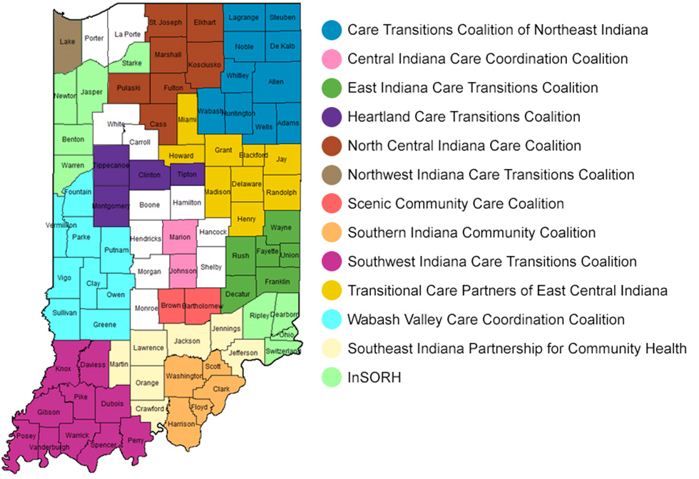
Community Coalitions
Qsource brings together Medicare beneficiaries, providers, and communities together in data-driven initiatives that increase patient safety, make communities healthier, better coordinate post-hospital care, and improve clinical quality.
In addition to improving clinical outcomes, Qsource works with communities to address population health concerns, often referred to as social determinants of health. These include concerns such as insufficient food resources, lack of transportation to follow up appointments, homelessness, among others.

Slide 24
Upcoming Webinars
9/20/2023 Care Coordination Series Part 2: Aging in Home Health Care Settings
9/27/2023 Care Coordination Series Part 3: Hospice Settings
10/3/2023 Social Drivers of Health-The Missing Link
10/12/2023 Closing the Health Literacy Gap and Advancing Health Equity

Slide 25
Resource Page Updated
Discover What’s New!
We've recently updated our Resources Web page to include Spanish translated materials and new topics.
Download the QR code and keep it handy to access the page on your mobile device. Or visit our Resources Page to view the latest tools, podcasts and on-demand webinars.

Slide 26
Thank You! Visit qio.qsource.org for more info!
This material was prepared by Qsource, a/an Network of Quality Improvement and Innovation Contractors under contract with the Centers for Medicare & Medicaid Services (CMS), an agency of the U.S. Department of Health and Human Services (HHS). Views expressed in this document do not necessarily reflect the official views or policy of CMS or HHS, and any reference to a specific product or entity herein does not constitute endorsement of that product or entity by CMS or HHS. 23.QIO.07.041

