Slide 1
Care Coordination Series Part 2: Home Health Care Settings
Presented By:
Todd Hunnicutt | Family Care Giving Program Manager| Aging and In-Home Services
Tammy Bay| Client Care Specialist| Living Well Home Care

Slide 2
Webinar: Agenda and Chat Rules
To ensure maximum sound quality, participant lines have been muted during the presentation; however, we welcome questions and comments via the chat box on the right-hand side of your screen
During the Q&A portion of the presentation, we will unmute your lines.
To submit questions or comments:
Use the chat box or,
Raise your hand to verbally ask your question
Opening Remarks
Housekeeping
Presentation
Q&A
Closing Remarks

Slide 3
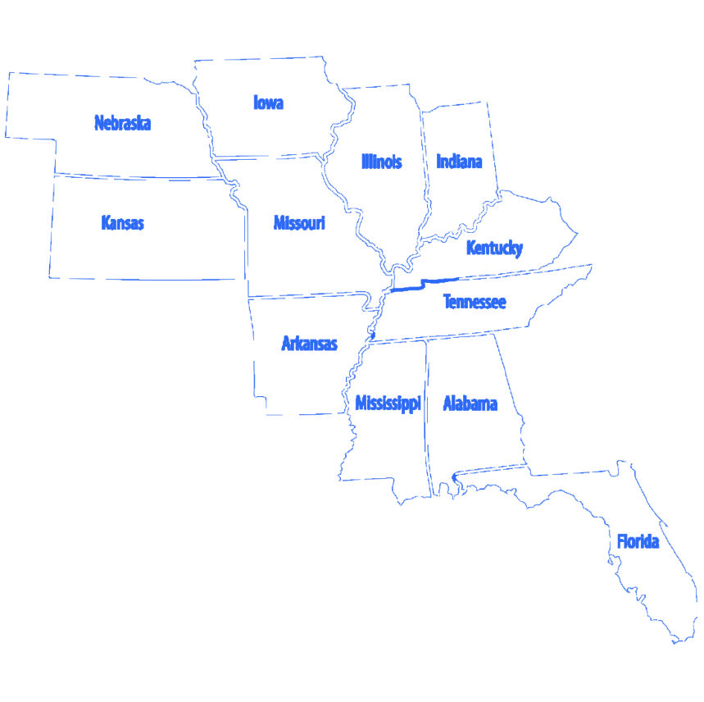
Qsource has more than 45 years of experience working with with healthcare providers, Medicare and Medicaid. Currently operate in 11 states overseeing ESRD, EQRO and QIO activities. Serves as the Medicare Quality Innovation Network-Quality Improvement Organization (QIN-QIO) for Indiana.

Slide 4
Polling Question
In what setting do you work in?
Ambulatory Care
Community Based
Home Health
Government
Pharmacy
Long-term Care
Hospital
Other

Slide 5
Polling Question
Polling Question
What is your role in your organization?
Health Educator
Heathcare Provider
Long-term Care Clinical Staff
Long-term Care Administrator
Patient Advocate
Quality Improvement Specialist
Nurse
Other

Slide 6
Hospital 2 Home
Todd Hunnicutt | Family Care Giving Program Manager| Aging and In-Home Services

Slide 7
Hospital 2 Home

Slide 8
Overview
H2H is a 30-day care transitions program dedicated to helping individuals with dementia or IDD prevent a hospital readmission and remain safely at home.
Support is provided by care coach and respite coach as often as needed
Evaluate problem areas/needs and assist with care planning
Discuss health conditions and hospitalization history to make a plan for better management of conditions
Assess caregiver stress and discuss strategies for preventing burnout
Discuss long term care options and complete referrals for services needed
Provide education on dementia/IDD when needed

Slide 9
Who is eligible?
Patients over age 60 with dementia or cognitive impairment – does not have to be diagnosed
Ex. MCI, age-related cognitive decline, Parkinson’s
Patients of any age with IDD
Patient is returning to community setting upon discharge from hospital or ER or following rehab
Does not have to have a designated caregiver – individuals living alone can greatly benefit from H2H as well
Hospitalization or ER visit was within last 14 days

Slide 10
Respite Services
Respite coach can provide in home respite for the 30-day duration of the program
Light housekeeping, meal prep, companionship, supervision
Cannot provide hands on care such as bathing, dressing, toileting, etc., or transportation
Number of hours allotted varies depending on needs, scheduling, and availability

Slide 11
H2H Benefits & Success Stories
Better understanding of long-term care options
Decrease in caregiver stress
Lower hospital readmission rate
Improved health outcomes
Increased knowledge on dementia
Person centered, comprehensive care plans

Slide 12
H2H By the Numbers
Total Number of dyad referrals to H2H program to date= 108 dyads (219 individuals)
48 dyads (97 individuals= 48 Caregivers (CG)/48 Care Recipients (CR))- did not participate in H2H.
Reasons included:
No response by caregivers after 3 attempts to offer program;
CG or CR were not interested;
CG refused program;
CR passed away in hospital prior to discharge;
CR moved out of state; and
CR to LTC for permanent placement.

Slide 13
H2H By the Numbers
43 dyads have participated to some degree or completed the 30-day H2H program (86 individuals=43 CG/43 CR).
8 caregivers did not respond after the initial meeting.
1 caregiver requested the end of the program prior to the end of 30-days.
5 care recipients moved to LTC or ALF during the 30-day program.
4 care recipients passed away during the 30-day program.
1 care recipient was readmitted for seizure disorder.
24 caregiver dyads have completed the full 30-day program.

Slide 14
H2H By the Numbers
9 dyads are on the active list (18 individuals=9CG/9CR) and the 30-day intervention is in progress.
8 dyads are on the pending list (16 individuals=8CG/8CR); outreach to set up in the initial meeting is in progress.
338 hours of respite service provided to date to 26 caregivers

Slide 15
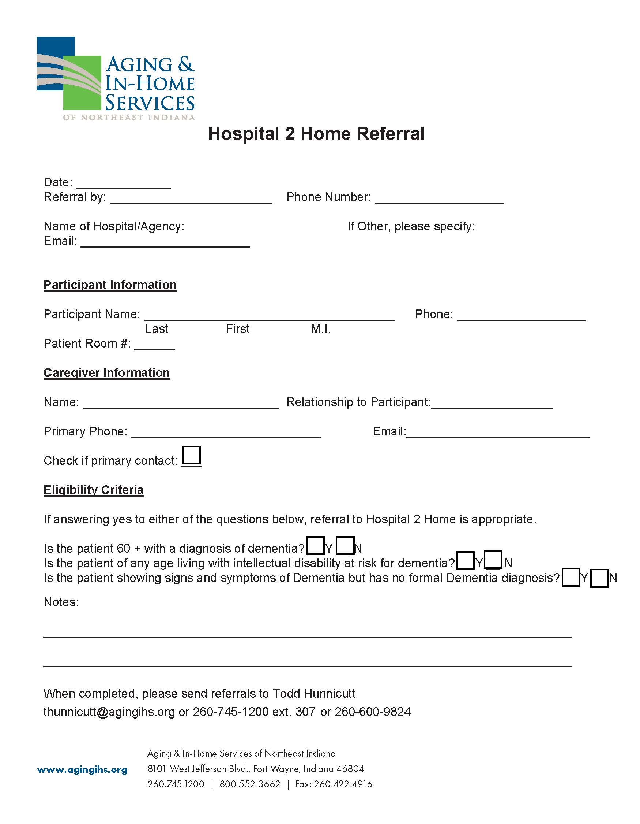
Process
Referral sources:
Parkview Hospitals
Lutheran Life Villages
American Senior Communities
Active Day
Case Management/ADRC
Referral form is filled out and emailed to Todd Hunnicutt
Referral can also be called in
Care Coach visits the patient bedside same day or within 24 hrs of receiving referral
Home visit is scheduled within 24-48 hrs of discharge from hospital or rehab

Slide 16
Success Story
We just wrapped up a successful 30 days with an individual who was providing care for her sister. The care recipient was initially hospitalized due to chest pain. Although it was determined to be musculoskeletal pain and not cardiovascular, her healthcare situation raised some concerns. Care recipient had been missing appointments frequently due to not having adequate transportation and not being able to walk up and down the stairs to her apartment unassisted.

Slide 17
Success Story
Because of this, she was dropped by her PCP and was unable to get her prescriptions filled, so she went without her medications for several weeks. Care recipient spent most of her time alone in her apartment as her sister works 10 hrs./day Mon-Thurs. Care recipient was not eating meals during the day and wouldn’t even go into the kitchen when her sister was not there. During their 30 days in H2H, they had Respite Coach, Jamie, coming in 2-3 days a week. Jamie helped with housework, companionship, and fixing meals for the care recipient.

Slide 18
Success Story
I also spoke with the caregiver weekly and helped her find transportation to doctor’s appointments, provided a list of senior housing options to help her find a more handicap accessible apartment, encouraged communication with new PCP when concerns arose, ensured that medications got refilled and were being taken as prescribed, discussed ways to ensure that care recipient eats during the day, and completed a referral for Family Caregiver Respite, Home Delivered Meals, and Medicaid Waiver through AIHS.

Slide 19
Success Story
Care recipient formed a close bond with Jamie during their respite time, and caregiver reported that she was very pleased with the program and very much appreciated the help and support it provided. Caregiver requested ongoing care coaching through another AIHS program, BRI, and will continue to have regular phone-based follow ups to continue helping her navigate challenges related to caregiving and dementia.

Slide 21
Living Well Home Care
Tammy Bay| Client Care Specialist| Living Well Home Care

Slide 22
Background
Living Well Home Care is a home care agency that assists clients to be able to stay in their homes.
We offer:
Homemaker services
Attendant care services
Respite care

Slide 23
Problem Statement and Goal
Client admission to hospital is usually unknown to us unless family informs us or caregiver arrives and no one is home.
Goal: Social Worker/Case Manager informing Home Care agency of Patient admission.
Client care in the clients home once the client is released from an ER visit or an extended hospital stay.
Goal: Limit readmission to emergency room.
To assist clients in strategies to reduce readmission
To assist clients with follow up appointments.

Slide 24
Intervention and Implementation
Tracking of clients visits to see patterns of habitual admission
Possible Hospice Care provider
Home visits to monitor client's home for possible patterns that lead to readmission
Communication with hospital staff and/ or client's family to insure proper care.

Slide 25
Barriers and Challenges
We do not get discharge forms upon release of the client to their home from the hospital.
We do not have communication with hospital for an ED visit.
We do not get communication from client’s managed care provider.

Slide 26
Strategies to Address Barriers and Challenges
Having discharge papers faxed to Home Care Agency would greatly benefit home care staff to better assist client for follow up appointments and attendant care services once client returns home.

Slide 27
Results
Client would be assisted in post admission care.
Client would be assisted with making follow up appointments.
Client would be transferred to those appointment by agency staff.

Slide 28
Best Practices and Lessons Learned
Educate, educate, educate client and family to notify our agency when they go to the ER or to the hospital
Build relationships with local facilities for improved communication

Slide 29
Thank You!
May 9, 2023
www.qsource.org

Slide 30
Q&A Session with Today’s Panelists

Slide 31
Your Feedback is Valuable
Polling Question
On a scale of 1 to 5 where 5 represents “Very Satisfied” and 1 represents “Very Dissatisfied”, indicate your level of satisfaction with this session. 5- Very Satisfied 4-Somewhat Satisfied 3-No opinion 2-Somewhat Dissatisfied 1-Very Dissatisfied | 1 | 2 | 3 | 4 | 5

Slide 32
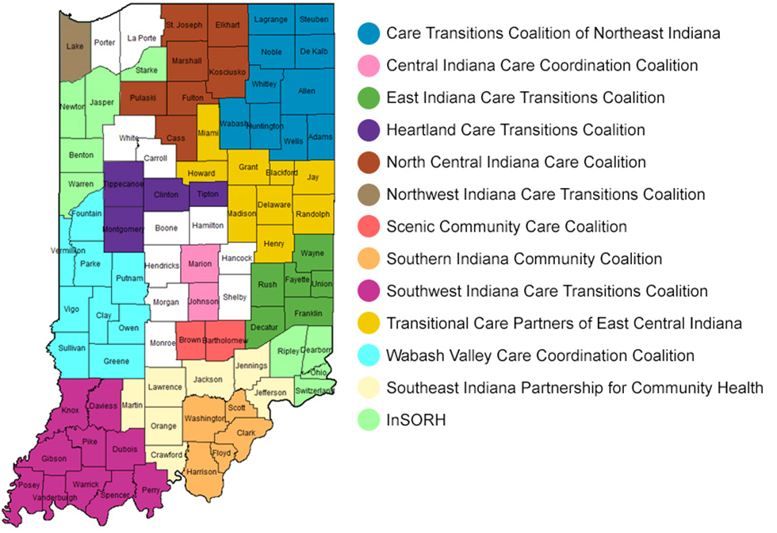
Community Coalitions
Qsource brings together Medicare beneficiaries, providers, and communities together in data-driven initiatives that increase patient safety, make communities healthier, better coordinate post-hospital care, and improve clinical quality.
In addition to improving clinical outcomes, Qsource works with communities to address population health concerns, often referred to as social determinants of health. These include concerns such as insufficient food resources, lack of transportation to follow up appointments, homelessness, among others.

Slide 33
Upcoming Webinars
9/27/2023 Care Coordination Series Part 3: Hospice Settings
10/3/2023 Social Drivers of Health-The Missing Link
10/12/2023 Closing the Health Literacy Gap and Advancing Health Equity

Slide 34
Resource Page Updated
Discover What’s New!
We've recently updated our Resources Web page to include Spanish translated materials and new topics.
Download the QR code and keep it handy to access the page on your mobile device. Or visit our Resources Page to view the latest tools, podcasts and on-demand webinars.

Slide 35
Thank You! Visit qio.qsource.org for more info!
This material was prepared by Qsource, a/an Network of Quality Improvement and Innovation Contractors under contract with the Centers for Medicare & Medicaid Services (CMS), an agency of the U.S. Department of Health and Human Services (HHS). Views expressed in this document do not necessarily reflect the official views or policy of CMS or HHS, and any reference to a specific product or entity herein does not constitute endorsement of that product or entity by CMS or HHS. 23.QIO.07.041

