Slide 1
Care Coordination Series Part 3: Hospice Settings and Advance Care Planning
Presented By:
Heather Taylor| Account Executive| Elara Caring
Rev. Michael Kinsey| Advance Care Planning Specialist| Parkview Health

Slide 2
Webinar: Agenda and Chat Rules
To ensure maximum sound quality, participant lines have been muted during the presentation; however, we welcome questions and comments via the chat box on the right-hand side of your screen
During the Q&A portion of the presentation, we will unmute your lines.
To submit questions or comments:
Use the chat box or,
Raise your hand to verbally ask your question
Opening Remarks
Housekeeping
Presentation
Q&A
Closing Remarks

Slide 3
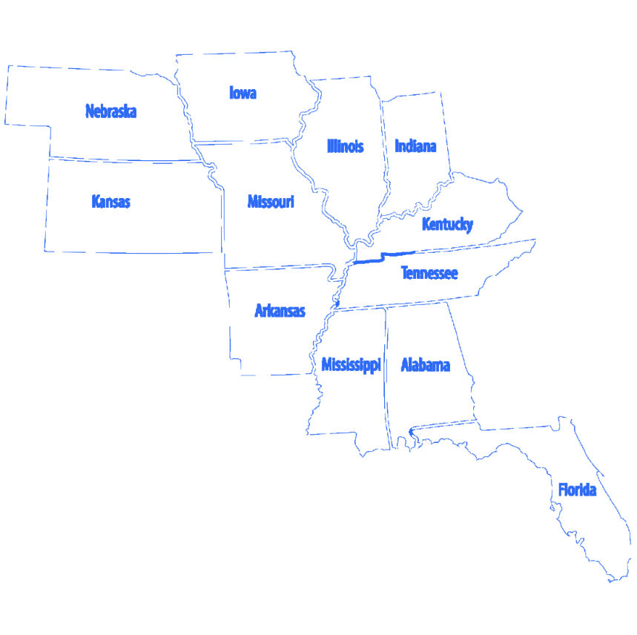
Qsource has more than 45 years of experience working with with healthcare providers, Medicare and Medicaid. Currently operate in 11 states overseeing ESRD, EQRO and QIO activities. Serves as the Medicare Quality Innovation Network-Quality Improvement Organization (QIN-QIO) for Indiana.

Slide 4
Polling Question
In what setting do you work in?
Ambulatory Care
Community Based
Home Health
Government
Pharmacy
Long-term Care
Hospital
Other

Slide 5
Polling Question
Polling Question
What is your role in your organization?
Health Educator
Heathcare Provider
Long-term Care Clinical Staff
Long-term Care Administrator
Patient Advocate
Quality Improvement Specialist
Nurse
Other

Slide 6
Hospice Care Heather Taylor | Elara Caring

Slide 7
The H Word
www.qsource.org
www.elara.com

Slide 8
What is the dreaded H Word?
The Term “Hospice”: is from the root word “HOSPITALITY”
Prior to the Medicare Hospice Benefit being established in the US in 1983, hospice care was provided by volunteers through grassroots efforts.
The 1st Hospice in the US was started in Connecticut in 1974
Hospice is the highest level of care that is covered 100% by Medicare, outside of a hospital setting.
Notes:
Last line is how I introduce myself. “Hi, my name is Heather with Elara caring, and I’ve been asked to come speak to you about the highest level of care Medicare covers 100% outside of a hospital setting, Do you have a moment to speak?

Slide 9
CMS Hospice Definition
“The emphasis of hospice care is on effective symptom management, with the goal of making the patient as physically and emotionally comfortable as possible, and enabling the patient to remain at home as long as possible with minimal disruption to normal activities of daily living.”
Notes:
Focus on prognosis not diagnosis.. Think of individuals in your life, or that you provide care for.. Now think 6 months ahead from today. Would you be surprised if that individual had passed away by Easter? If you would not be surprised that it someone you need to connect to hospice care.

Slide 10
Connecting to service is easy, but often too late
According to the NHPCO (National Hospice and Palliative Care Organization) over HALF of the patients connected to Hospice care only get about 18 days of care on average.
The goal: Refer to hospice sooner to ensure individuals and their families receive the minimum of 180 days of care they are entitled to. Doing so will :
Enhance quality of life
Allow Focus on personal goals
Encourage minimal disruptions to daily activities
Provide support for patients & families when needed most
Reduce unnecessary ER visits and hospitalizations
Notes:
When I speak with families that I've connected to service I typically get the following:
I wish we had started sooner?
Why didn’t my doctor push for my loved one to get hospice sooner?
We have been in and out of the ER a dozen times with no relief, how come they didn’t call you in?

Slide 11
What can we do as a whole in the Healthcare community?
Provide ample hospice education to patients upon initial diagnosis of a disease that is terminal (i.e. a disease that has no cure) such as these common hospice diagnoses:
Alzheimer’s, COPD, CHF, Cancer, Parkinson's
Hospice and palliative care educated individuals having the ability to meet with clinicians and physicians' regarding hospice eligibility and connecting patients to the service.
Allow a referral to hospice care, even if you feel it’s too early.
Find a new way to initiate conversation about hospice
I work with several great people whose jobs are to ensure your symptoms are managed at home, would you be interested in hearing more?
I think you could benefit from Medicare's highest level of care in the home, can I have my contact person reach out?

Slide 12
How do I know when someone is possibly eligible for hospice?
Have you noticed . . .
Weight loss?
Declining appetite or refusing to eat?
Needing more help with activities of daily living?
Increased fatigue?
Withdrawal or loss of interest from normal activities?
Unexplained loss of bodily functions?
Individuals with an Alzheimer’s or related diagnosis having a decrease in the ability to communicate?
Angina at rest or discomfort with activity?
Increased use of oxygen?
Frequent hospitalizations because of:
Cardiac or respiratory exacerbations
Recurrent infections
Falls

Slide 13
Barriers and Challenges
Insecurity in defining the palliative phase
Knowledge deficit in identifying patients who are approaching end of life
Lack of confidence in having end of life conversations
Inexperience with certain disease processes, resulting in insecurity with responding to “gut feelings”
Time pressure
Unsure who is responsible for having end of life conversations
Myths of hospice care being used to provide education to those in need. (i.e. you cannot continue to see your doctor, you cannot continue medications, Hospice is place you go)
Patients being led toward rehabilitation and curative treatments without having a realistic quality vs quantity discussion.

Slide 14
Overcoming Barriers and Challenges
Begin having the conversation sooner, it’s never too early
Stop using negative verbiage such “unfortunately” or apologizing when speaking of electing hospice care.
Allow hospice trained/certified individuals to have the conversation. Although all hospice companies follow CMS guidelines each one may have unique programs that cater to different families needs.
Guidelines for hospice care are constantly changing, allowing the trained individual to educate families will help to eliminate any myths of hospice care that are being spread.
Become more educated as a community on hospice so we can have better conversation.

Slide 15
It is the patient’s right to be informed of the prognosis and determine goals of care
If we don’t work to overcome barriers, patients are at risk of receiving care they do not want

Slide 16
Benefits to starting the Conversation sooner…
Earlier conversations allow for the establishment of goals for patients and families
Allows for opportunity to reconcile or confess past hurt(s) and ask forgiveness
To be fully informed about treatment options – aggressive versus palliative
Better understanding of their illness and prognosis may decrease the perception of a medical crisis
Would allow the patient and family to be a part of the treatment plan

Slide 17
Results
A 2007 report by the National Hospice and Palliative Care Organization (NHPCO) found that patients with certain terminal diseases who chose hospice lived an average of 29 days longer than similar patients who did not receive hospice. The findings not only dispel the myth that hospice hastens death but also suggest hospice could prolong life for patients with certain conditions.
President Carter elected hospice care in Feb 2023, meaning he just surpassed his 6th month in care. He is set to celebrate his 99th birthday Oct 1st in his home surrounded by family and friends.
“We’ve never heard anyone say, ‘Gosh, I wish I had less time on hospice,’” Marcantonio said. “The more we can get past those myths … and those misperceptions that we mentioned, the more people will get the care that they need when they need it.” – Ben Marcantonio-CEO, NHPCO

Slide 18
Best Practices and Lessons Learned
Ensure your understanding of the Medicare Hospice Benefit before discussing hospice with patients.
2. For any patient with a diagnosis of a serious illness, use every visit to:
Build trust by listening to the patient’s story.
Ask questions to understand the patient’s values and care preferences.
Match values and preferences to the appropriate therapy or services. This process lays the foundation for conversations about hospice.
3. When a patient becomes eligible for hospice services, suggest holding a family meeting to discuss the Medicare Hospice Benefit and the value of hospice care (ideally in-person, but use video or phone call if needed):
Use the patient’s advance directive to help the conversation focus on goals and plan.
Avoid medical terminology. Opt for language one uses when talking to a friend or relative. Allow for silence and reflection.
4. Let the patient’s needs be the focus of the conversation:
Start by asking the patient and family about their understanding of the patient’s medical condition. If they understand the condition is not curable, move the conversation forward with phrases such as, “We are in a different place now. Knowing this, what is most important to you?”

Slide 19
Once wishes are clarified, describe the types of support that would address current needs, such as frequent visits from a nurse or additional help at home. It can be helpful to describe relevant features of the service before naming it, such as “A program covered by your insurance that will cover the costs of a team of professionals and their services, including weekly home nursing, doctor or nurse practitioner visits if needed; your lung and breathing medications; and any medical equipment you may need. The team could also include a nursing assistant to help with some tasks like bathing or feeding, and a social worker to see how everyone is managing and to make sure you have all the equipment you need. The program is called hospice.”
Explore the patient/family’s familiarity with and perceptions of hospice. Be prepared to respond to an emotional reaction to your recommendation and to then clarify misunderstandings about how the service works.
Recognize that race and culture can impact patient and family attitudes about hospice. For example, our history of systemic racism and medical mistreatment in U.S. health care has led many Black patients to distrust hospice care. Skilled communication, framing the hospice conversation around the patient's needs and values, and respecting decision-making preferences with families can help to facilitate trust.
If hospice care is aligned with the patient’s needs and values, recommend hospice using language that connects back to what is important to the patient. For example, “What I heard you say is that staying in your house and avoiding time in the hospital, having the right medications to manage your symptoms, and having the best quality of life possible is most important to you now. I recommend hospice because that team can provide you with the maximum support at home. That and you are entitled to—and have paid for—the hospice benefit as Medicare beneficiaries.”
Describe the hospice benefit package, including:
No cost-sharing for patient
Full team including volunteer services
24/7 on-call support and regular nurse visits
Home-delivered supplies, medications, and equipment
Hospice supports family or other hired caregivers to take care of patients. It does not include 24-hour care in the home.
Remind patients and families that hospice care is not a one-way street; patients can change their mind and dis-enroll if their goals change, or if hospice is not meeting their needs.

Slide 20
Polling Question
Would your organization be interested in additional hospice training in your facility, office, or department?
Yes
No
If you are interested, please leave your contact information in chat, or contact Heather at:
htaylor1@elara.com
812-214-1670

Slide 21
If death is inevitable, one should try to die well. ~Mary Jo Putney, Dark Mirror
May 9, 2023
www.qsource.org

Slide 22
www.qsource.org
Parkview Health Advance Care Planning and Care Coordination
Erica Downing, MSW, LSW
Rev. Michael Kinsey, MAOL

Slide 23
Background – Advance Care Planning Conversations
ACP conversations include reflection, understanding and discussion about values, goals, and treatment preferences to help ensure that the plan of care is truly person-centered.
Notes:
ACP is a process of communication for planning for future medical decisions. To be effective, this process includes:
Reflection on goals, values, and beliefs (including personal, cultural, and spiritual)
Understanding of possible future situations and decisions
Discussion of these reflections and decisions with those who might need to carry out the plan
It is vitally important that people understand: You can have a say in your care. Treatments only work if they work for you.

Slide 24
Polling Question
Who has completed their own Advance Care Directive?
Yes
No

Slide 25
Background –Advance Care Planning Program
The Advance Care Planning (ACP) Program at Parkview Health went live on May 15, 2017.
Chose and integrated the Respecting Choices® model of ACP.
Start Small; Think Big:
Certified ACP Facilitators in waves.
Currently have 150+ certified ACP facilitators within the Parkview Health System and surrounding community.
Intentionally chose teams that would have opportunity to facilitate ACP conversations.

Slide 26
Problem Statement and Goal
Problem Statement: Not all patients have easy access to ACP services due to social determinates of health as well as challenges imposed by the COVID-19 global pandemic.
Goal: Collaboration with other facilitators to support patients’ ACP needs to minimize the barriers that impact participation.

Slide 27
Intervention and Implementation
Take our ACP program to our patients and community.
Do not always expect patients and community members to come to us.
Utilize technology as much as possible to conduct ACP visits.
Present in a variety locations.
Assisted Livings, Long-Term Care, Local Housing Authority Complexes, Local Community Center.
Support teams who are providing ACP services.
Capitalize on existing relationships between facilitators and patients.

Slide 28
Barriers and Challenges
Unpredictability of the global pandemic (COVID-19).
Adjustment of working in office to working remotely and the impact on ACP.
Visitor limitations in facilities due to pandemic.
Patients receiving calls from multiple health system employees and juggling multiple scheduled appointments.
Generational struggles with technology.

Slide 29
Strategies to Address Barriers and Challenges
Use of technology to conduct ACP visits.
Zoom, Microsoft Teams, MyChart Video Visit
Telephonic conversations
Including patient family members to assist with technology and be part of the conversation.
Supporting ACP teams by mailing ACP materials to patients scheduled for ACP conversations or requesting information on ACP.
Capitalizing on existing relationships between ACP facilitators and patients who accepted ACP invitation.
Care coordination

Slide 30
Results
By taking ACP to our patients (meeting where they are), the barrier of access, including transportation, is eliminated.
Supporting other ACP teams allows for continued ACP visits.
Using technology provides comfort and flexibility for patients not wanting to leave their home or have others come to their home.
Utilizing existing relationships between patients and ACP facilitators allows for comfort for both parties.

Slide 31
Best Practices and Lessons Learned
Meet patients in their environment, whenever able.
Comfort helps ease the nervousness of having crucial ACP conversations.
Conversation location: Home vs. Hospital/Clinic
Existing relationships
Technology helps those concerned about spread of illnesses.
Development and use of multiple reports providing crucial data for ACP teams to improve access.

Slide 32
Thank You
September 27, 2023
www.qsource.org
Parkview Advance Care Planning Contact Info
Email: acpdept@parkview.com
Phone: (260) 266-1481

Slide 33
Q&A Session with Today’s Panelists

Slide 34
Your Feedback is Valuable
Polling Question
On a scale of 1 to 5 where 5 represents “Very Satisfied” and 1 represents “Very Dissatisfied”, indicate your level of satisfaction with this session. 5- Very Satisfied 4-Somewhat Satisfied 3-No opinion 2-Somewhat Dissatisfied 1-Very Dissatisfied | 1 | 2 | 3 | 4 | 5

Slide 35
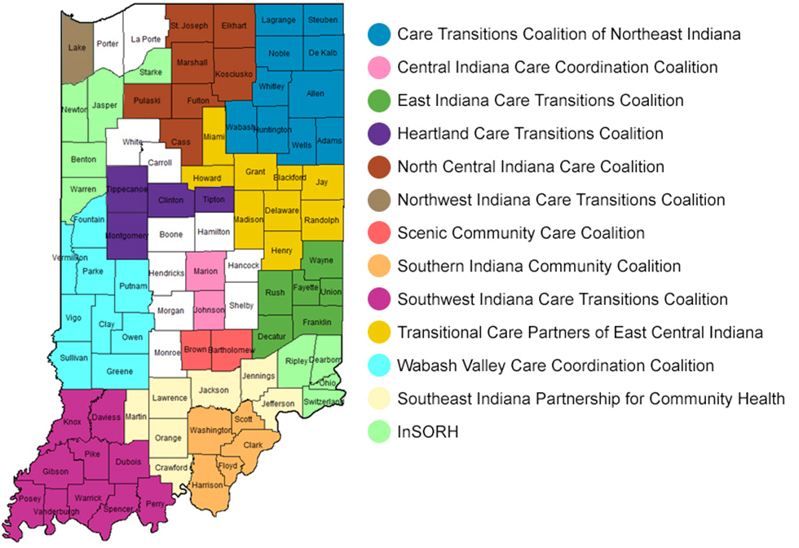
Community Coalitions
Qsource brings together Medicare beneficiaries, providers, and communities together in data-driven initiatives that increase patient safety, make communities healthier, better coordinate post-hospital care, and improve clinical quality.
In addition to improving clinical outcomes, Qsource works with communities to address population health concerns, often referred to as social determinants of health. These include concerns such as insufficient food resources, lack of transportation to follow up appointments, homelessness, among others.

Slide 36
Upcoming Webinars
10/3/2023 Social Drivers of Health-The Missing Link
10/12/2023 Closing the Health Literacy Gap and Advancing Health Equity

Slide 37
Resource Page Updated
Discover What’s New!
We've recently updated our Resources Web page to include Spanish translated materials and new topics.
Download the QR code and keep it handy to access the page on your mobile device. Or visit our Resources Page to view the latest tools, podcasts and on-demand webinars.

Slide 38
Thank You! Visit qio.qsource.org for more info!
This material was prepared by Qsource, a/an Network of Quality Improvement and Innovation Contractors under contract with the Centers for Medicare & Medicaid Services (CMS), an agency of the U.S. Department of Health and Human Services (HHS). Views expressed in this document do not necessarily reflect the official views or policy of CMS or HHS, and any reference to a specific product or entity herein does not constitute endorsement of that product or entity by CMS or HHS. 23.QIO.07.041

