Slide 1
Closing the Health Literacy Gap: Advancing Health Equity
Presented By:
Pooja Kothari, RN, MPH | Health Equity SME | Qsource
Michelle Brantley, BS |Case Management Supervisor | LifeSpan Resources

Slide 2
Webinar: Agenda and Chat Rules
To ensure maximum sound quality, participant lines have been muted during the presentation; however, we welcome questions and comments via the chat box on the right-hand side of your screen
During the Q&A portion of the presentation, we will unmute your lines.
To submit questions or comments:
Use the chat box or,
Raise your hand to verbally ask your question
Opening Remarks
Housekeeping
Presentation
Q&A
Closing Remarks

Slide 3
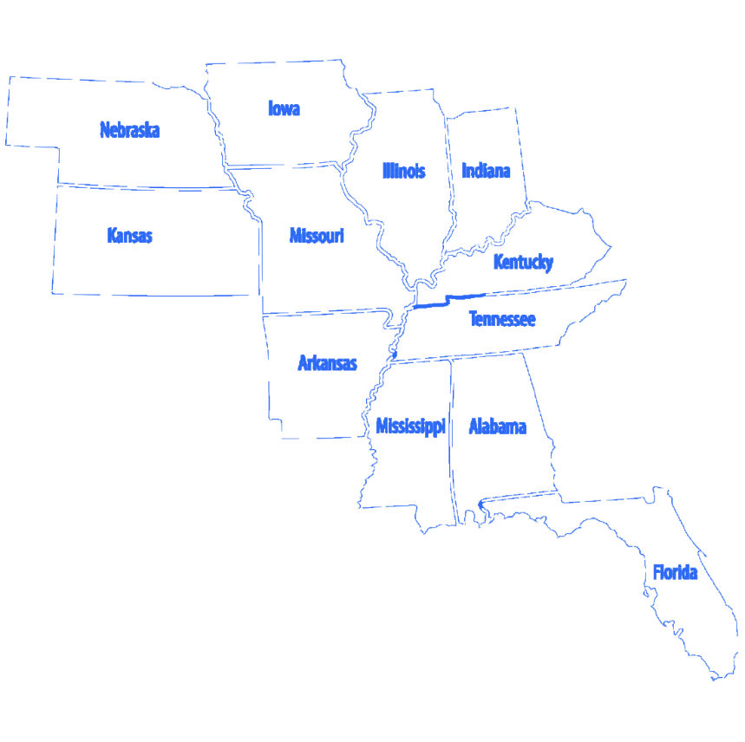
Qsource has more than 45 years of experience working with with healthcare providers, Medicare and Medicaid. Currently operate in 11 states overseeing ESRD, EQRO and QIO activities. Serves as the Medicare Quality Innovation Network-Quality Improvement Organization (QIN-QIO) for Indiana.

Slide 4
Polling Question
In what setting do you work in?
Ambulatory Care
Community Based
Home Health
Government
Pharmacy
Long-term Care
Hospital
Other

Slide 5
Polling Question
Polling Question
What is your role in your organization?
Health Educator
Heathcare Provider
Long-term Care Clinical Staff
Long-term Care Administrator
Patient Advocate
Quality Improvement Specialist
Nurse
Other

Slide 6
www.qsource.org
Closing the Health Literacy Gap: Advancing Health Equity
Pooja Kothari, RN, MPH
Health Equity SME, QSource
October 10, 2023
Notes:
Hi, I’m Pooja Kothari, a health equity, SME with Qsource.
Today I’ll be presenting on closing the health literacy to advance health equity
It’s not a coincidence that we’re here together talking about health literacy – it’s health literacy month!

Slide 7
What is Health Literacy?
Personal health literacy is the degree to which individuals have the ability to find, understand, and use information and services to inform health-related decisions and actions for themselves and others.
Organizational health literacy is the degree to which organizations equitably enable individuals to find, understand, and use information and services to inform health-related decisions and actions for themselves and others.
Notes:
Polling question: Do you know what CLAS standards are? Yes, no
Polling question: How knowledgeable are you about the CLAS standards that relate to health literacy? Very knowledgeable, somewhat knowledgeable, not knowledgeable
Healthy People 2030 provides the following definitions of personal and organizational literacy.
Personal health literacy is really about empowering an individual so they they are able to find, understand and use information to make decisions for themselves. It’s not about just understanding information, it’s using it to make well-informed choices.
The organizational definition is important, it provides some accountability that organizations have a responsibility to address health literacy.
Health literacy really helps to advance health equity – which allows everyone to have a fair and just opportunity to be as healthy as possible

Slide 8
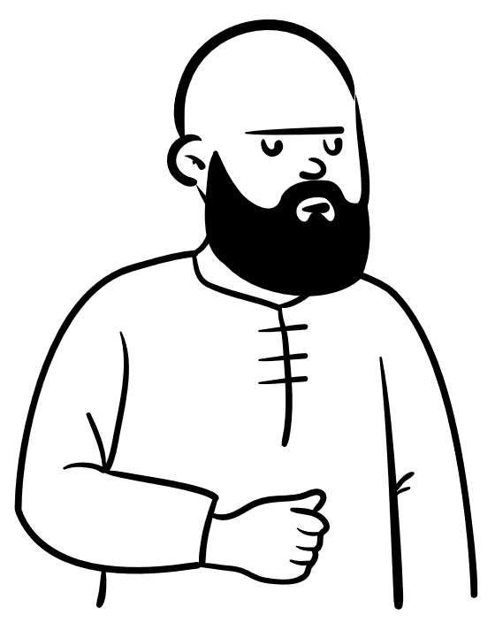
Let’s Meet John…
He’s feeling dizzy, suddenly can’t see very well, and has been very tired recently.
He works long days as a mechanic, and his first language is Spanish, but he can both read and speak English. He lives an hour away from the nearest pharmacy.
His typical lunch is rice and beans with a beef stew. He doesn’t drink coffee but has a Coke since it’s refreshing and has caffeine.
Notes:
Let’s walk through a quick exercise, I’m going to read a brief case study to you, please type into chat any specific terms that you think are problematic to health literacy.
Let’s meet John – he’s been working at an auto shop, he’s a mechanic, he’s feeling dizzy and can’t see very well. His coworkers suggest he go straight to a hospital. The doctors run some tests and diagnose him with type 2 diabetes. Here’s the how the conversation goes…
Hi Mr. John. Your test results came back and your Hemoglobin A1c was very elevated, it looks like you have type 2 diabetes. It means your body doesn’t use insulin properly. Let’s focus on eating more of a balanced diet, reduce your carbohydrate and sugar intake.
Also, we need to change your medication for hypertension. Please go to your pharmacy and they will give you the updated medications – you now have to take 2 medications instead of 1.
John walks over to the pharmacy, here’s the conversation..
This is your Enalapril, take it orally every 12 hours with food. The doctor also prescribed Chlortalidone, take that one twice a day with an empty stomach.

Slide 9
Health Literacy ?!?
Your test results came back and your Hemoglobin A1c was very elevated, it looks like you have type 2 diabetes. It means your body doesn’t use insulin properly. Let’s focus on eating more of a balanced diet, reduce your carbohydrate and sugar intake. Also, we need to change your medication for hypertension. Please go to your pharmacy and they will give you the updated medications – you now have to take 2 medications instead of 1.
This is your Enalapril, take it orally every 12 hours with food. The doctor also prescribed Chlortalidone, take that one twice a day with an empty stomach.
Notes:
This may not be a typical conversation with a healthcare provider, he might get some educational material, more direction, and there might be more shared decision-making, a lengthier conversation about diabetes, a referral to a diabetes educator. Which is all great!
BUT often times, we use jargon, big words, and don’t explain things. Here’s some words highlighted in red, that we really need to focus on explaining. A lot of this is healthcare lingo/jargon. You could have someone who’s preferred language that is English who still doesn’t understand a lot of what this means.
When we’re talking to patients, educating them, asking them to make lifestyle adjustments, changing their medications – we need to take a step back and really think about how to make sure we put them in the best possible position so that they are able to make the best decisions for themselves and their family using the information we give them

Slide 10
Let’s Think about John:
I see Spanish is your preferred language, Here are some materials about diabetes in Spanish, let’s find time to connect you with a diabetes educator who also speaks Spanish.
Race, ethnicity, and preferred language
He works long days as a mechanic, and his preferred language is Spanish, but he can both read and speak English. He lives an hour away from the nearest pharmacy.
His typical lunch is rice and beans with a beef stew. He doesn’t drink coffee but has a Coke since it’s refreshing and has caffeine.
Health literacy
What’s your nearest pharmacy? Oh, it’s an hour away. We can ask the pharmacy to send you a 30-day refill to your home.
Social drivers of health
It sounds like rice and beans is a staple in your culture, let’s talk about your food options and how to fit it in given your work schedule. We have some recipe cards in Spanish that provide some alternative options.
Culturally and linguistically appropriate services
Notes:
Dissecting some of the components of health equity – including health literacy, you know his preferred language is Spanish, maybe we can give him materials in Spanish, connect him with a diabetes educator who also speaks Spanish.
Thinking about social drivers of health, transportation might be a barrier, maybe we can work with the pharmacy to make it easier for him to get medication refills.
Considering his culture and preferences – food and culture are inextricably linked, let’s understand where he’s coming from and how to meet him where he is – rice and beans might be a staple in his culture and also a quick meal to prepare given his work hours; maybe there are some ways to improve options and his uptake of vegetables.
You may have heard the term culturally and linguistically appropriate services – it just means factoring in his personal preferences, culture, language preference and using that information to help him.

Slide 11
Health Equity: everyone has a fair and just opportunity to be as healthy as possible
Provide respectful and trauma-informed care
Collect Race, Ethnicity and Language Preference (REAL) and Sexual Orientation and Gender Identity (SOGI) data
Conduct social drivers of health screening, connecting patients with resources, and closing the referral loop
Provide Culturally and Linguistically Appropriate Services (CLAS)
Listen to patients and families and engaging them in their care
Connecting the Pieces
Notes:
These are all the building blocks of trying to advance health equity, and health literacy is a key piece!

Slide 12
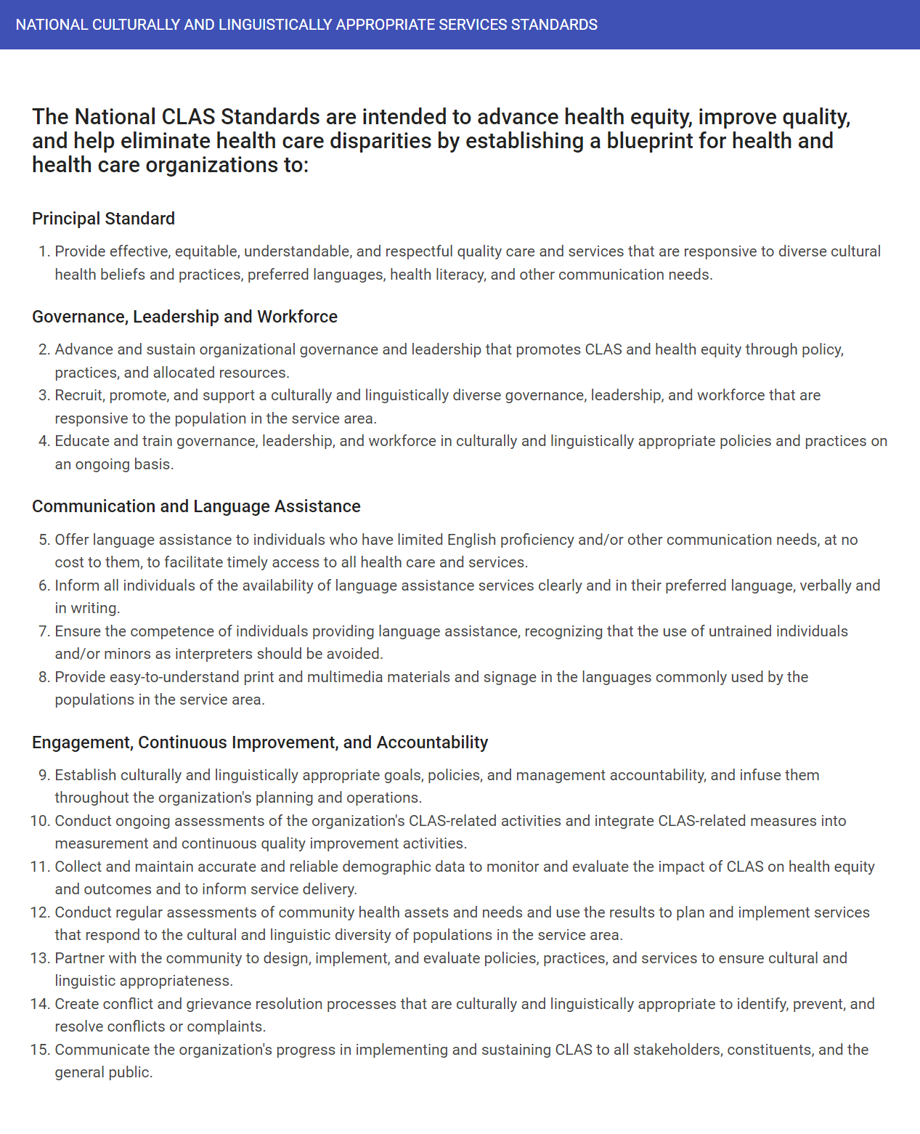
What are CLAS Standards?
Culturally and linguistically appropriate services (CLAS) ensure that the services you and your organization provide are respectful and responsive to each patient’s culture and communication needs.
The CLAS Standards provide health care organizations with 15 actionable steps for providing appropriate services.
Notes:
The HHS Office of Minority Health published National CLAS Standards in 2000 and updated them in 2013 to advance health equity and improve quality of care. The CLAS Standards provide health care organizations with 15 actionable steps for providing appropriate services.
CLAS helps advance health equity to ensure that every person can “attain his or her full health potential” and no one is “disadvantaged from achieving this potential because of social position or other socially determined circumstances.” While many factors impact health equity, providing culturally and linguistically appropriate services can be effective at improving healthcare quality and outcomes.
Culture plays an important role in health beliefs, behaviors, and practices as well as communication styles and treatment adherence.

Slide 13
#2 Communication and Language Assistance
Complete an organizational assessment specific to language assistance services
Standardize procedures for staff members and train staff in those procedures
Provide individuals with notification that describes what communication and language assistance is available, in what languages the assistance is available, and to whom they are available
Provide financial and/or human resource (e.g., time off) incentives to staff who complete interpreter training and meet assessment criteria
Formalize processes for translating materials into languages other than English and for evaluating the quality of these translations
Require that all individuals serving as interpreters complete certification
Notes:
#1 – REaL data, publicly available data on communities served
#2 – Script for staff, signage, forms in multiple languages
#3 – Free of charge translation
#4 – Build organizational capacity
#5 – Support staff, provide straining to all staff on what’s offered and available and how patients/families can access it

Slide 14
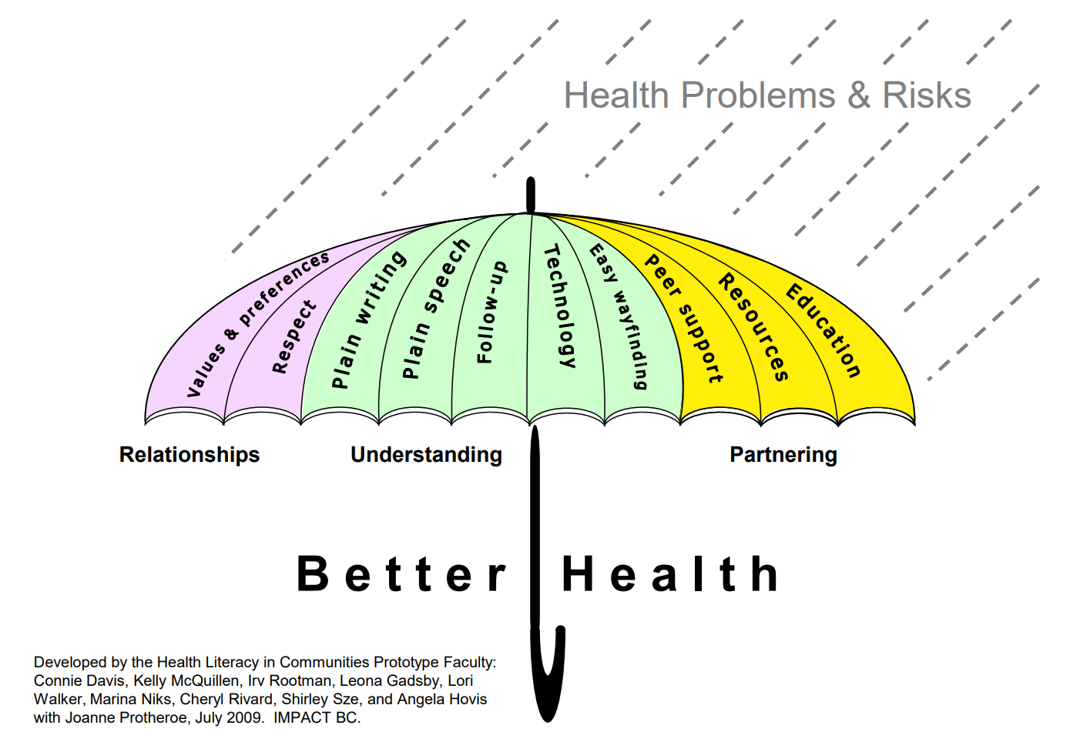
The Health Literacy Umbrella
Notes:
This Canadian organization made a nice toolkit and developed this image of health literacy and how it can help protect against health problems and risks and it talks about all the dimensions I covered earlier:
Considering personal values, preferences
Respecting cultural backgrounds and beliefs
Encouraging how one understands information – use plain writing, speech, follow-up with appropriate resources and materials, think about using technology but also understand that it can be a barrier to (digital literacy is a whole other issue), and make sure it’s easy for people to find their way around both physically and using information (think about signage – someone didn’t know to go to the radiology department because that’s where you get an x-ray)
Partnering with patients, families, and communities – asking them if what you’re doing is working, finding appropriate resources via peers, community-based organizations and identifying ways to educate the community … some great examples of Black barbershops used to have conversations about high blood pressure, partnering with the local Y for the diabetes community group and promoting physical activity.

Slide 15
How’s John Doing?
Health outcomes
Cost
Patient experience
Health equity
Plain writing, education, follow-up, technology
He read the diabetes pamphlets in Spanish and had a few questions for the diabetes educator. He messaged him on the portal.
He can’t attend the hospital’s diabetes support group because of work, but he was connected to the local fitness and nutrition program at the Y.
He still has rice and beans with beef stew but eats less rice and added vegetables. He stopped drinking his daily Coke but has it occasionally.
Resources and peer support
Values & preferences
Notes:
Going back to John – think about all the pieces we’re starting to put in place
Providing resources, he can read in a manner that’s understandable and not overwhelming, addressing his questions via technology (he might not have time to call during the day but can communicate with his team asynchronously).
Identifying ways to link resources in his community that he’s able to join given his interest and time
Making progress on his goals – improving his diet by taking into account his values and preferences
As we all know, change doesn’t happen overnight, but all the dimensions of health equity help with building trust, promoting a good relationship between patient and provider, and communication is key to all of this!
Ultimately this impacts health outcomes, overall cost, patient experience, and health equity.

Slide 16
Resources
HHS/OMH: CLAS, Cultural Competency, and Cultural Humility – overview of cultural competency and cultural humility strategies
HHS/OMH: Communication Styles – guide on cultural differences for communication styles
HHS/OMH: Effective Cross-Cultural Communications Skills – tips on how to improve your organization’s cross-cultural communication skills
HHS/OMH: ADDRESSING Framework – a useful mnemonic for key social identities to consider for getting to know a patient’s cultural identity
HHS/OMH: RESPECT Model – a model for how to engage patients in a culturally and linguistically competent manor
HHS/AHRQ: The SHARE Approach Quick Reference – a five-step process for shared decision making that explores what matters most to the patient
HHS/AHRQ: Be More Engaged in Your Healthcare: Tips for Patients – a tool to empower patients to engage in shared decision making with their healthcare providers
CMS: Guidelines to Developing a Language Access Plan – comprehensive guide on how to create a language access plan to ensure individuals with Limited English Proficiency receive appropriate assistance
HHS/OMH: Working Effectively with an Interpreter – tips on how to work with an interpreter
LEP: Translation – several resources on translation including language identification cards, toolkits for written translations, guides for making written material clear and effective

Slide 17
Thank You
May 9, 2023
www.qsource.org
Notes:
Polling question: How knowledgeable are you about the CLAS standards that relate to health literacy? Very knowledgeable, somewhat knowledgeable, not knowledgeable

Slide 18
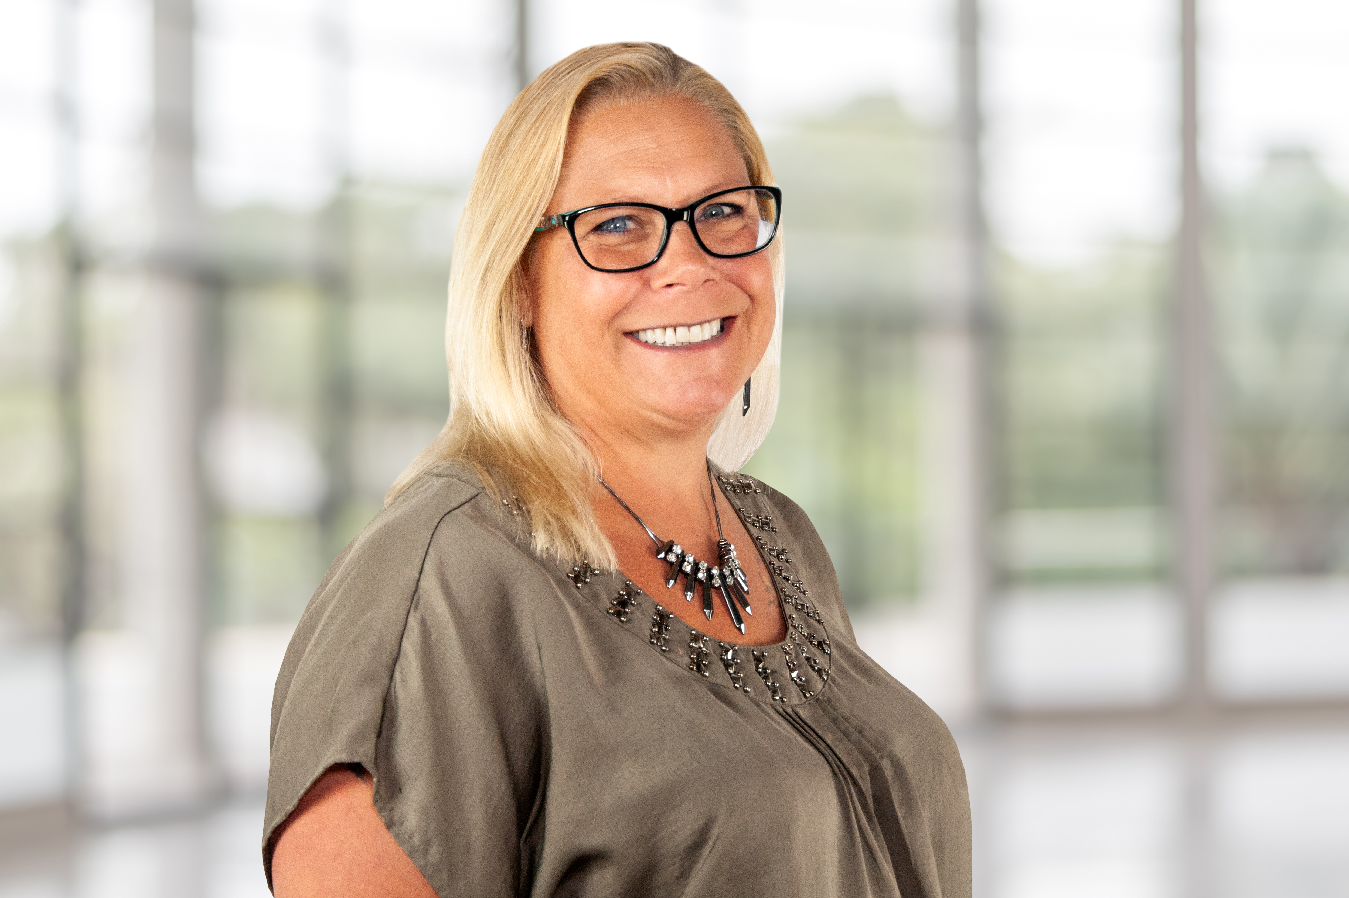
www.qsource.org

Slide 19
Background
Michelle has been with LifeSpan Resources for 10 years. She has over 20 years of social work and case management experience.
Michelle has been the Co-Chair of the Diversity, Equity, and Inclusion committee at LifeSpan Resources since its creation in 2020 following the tragic deaths of George Floyd and Breonna Taylor.

Slide 20
Problem Statement and Goal
After the deaths of George Floyd and Breonna Taylor, LifeSpan Resources’ staff looked to our executive team for a statement. After issuing a compassionate response, the Diversity, Equity, and Inclusion committee was formed.
The goal is to address any inequities and/or lack of inclusion within our agency and/or the clients we serve.

Slide 21
Polling Question
Do you feel that your organization communicates effectively about its DEI efforts?
Yes
No

Slide 22
Intervention and Implementation
Initiative/Action Item | Short Term | Long Term |  | Higher Priority | Lower Priority
DEI statement/mission (and posted on website) | X |  |  | X
Bathroom Gender Labels |  | X |  |  | X
Office culture: artwork, signage, messaging about empathy, respect, etc. | X |  |  | X
Pronouns |  | X |  |  | X
Onboarding process |  | X |  | X
Management team training |  | X |  | X
Bi-annual all staff training |  | X |  | X
Board Training
Article in Monthly Newsletter- Plan out topics | X |  |  | X
What are we doing to attract diverse candidates for open positions? | X |  |  | X
What job boards are we posting to? | X |  |  |  | X
Anything on our website about our commitment to diversity?
Review of employee handbook from a diversity and inclusion lens | X |  |  | X
Review job postings for DEI language | X |  |  | X
Marketing
Website and Materials Audit | X
Multi-lingual materials in-print and online | X
Diversity in groups represented in our marketing materials | X
Be intentional about posting stories of minorities on social media | X
The committee originally had 6 members and a local expert assisted in creating the committee’s organization structure. The committee has since met monthly to address a host of topics:

Slide 23
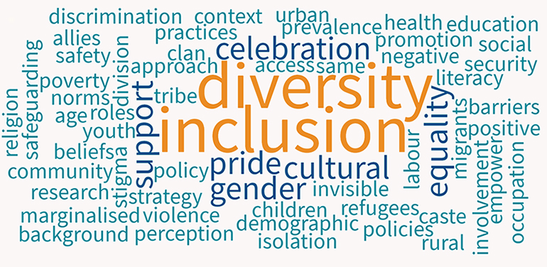
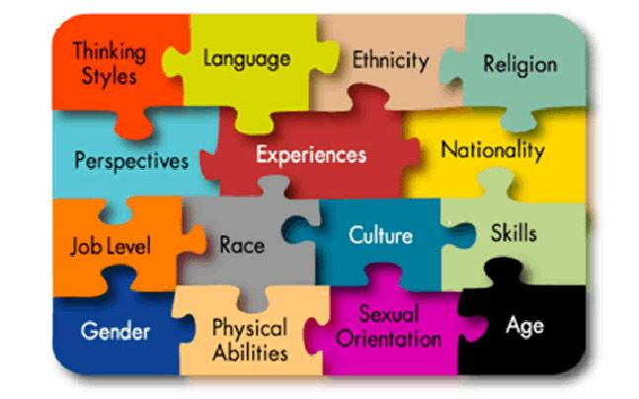
Inclusive Artwork Around the Offices

Slide 24
Polling Question
Have you received training on conscious bias or diversity and inclusion?
Yes
No

Slide 25
Intervention and Implementation
We participated in a program funded by The United Way to collaborate with Spalding University to review our hiring practices, policies and procedures, and the work the committee was doing. This was a year long program. We completed a self-assessment tool, and they provided feedback on areas we could improve. In the end, they determined our proactive efforts were exceptional and provided some resources to help us continue to meet our goals.

Slide 26
Intervention and Implementation
To ensure our clients were included in our efforts, we made sure our website and materials were available in multiple languages. We also signed contracts with interpreter services, which include ASL.
We have hired case managers that are multi-lingual.
Committee members have attended ongoing trainings to further their DEI knowledge and we have had DEI speakers at our full-staff meetings.
The committee completes monthly educational articles on DEI topics and those are published to our outreach materials, which go to staff and the community.
The committee created a vision and mission statement, which was added to our website.

Slide 27
Polling Question
Are there visible role models within the organization that you can relate to?
Yes
No

Slide 28
Barriers and Challenges
A barrier in the beginning was lack of diversity in our committee.
As a newly funded committee there was a lack of funding for more ambitious goals, such as agency-wide DEI trainings.
Lack of involvement in the committee and suggestions from staff outside of the committee. (Upon formation, the committee only had 6 members.)

Slide 29
Strategies to Address Barriers and Challenges
As committee members have changed or been added, we have added more diversity to more closely resemble the make-up of our local communities. We have also broadened the reach of our job postings by sharing to ethnic-specific platforms.
As we have grown as a committee, we have looked for opportunities that were free or low-cost and the executive team has supported these efforts.
The committee continues to ask staff for suggestions or comments at each full-staff meeting.

Slide 30
Results
In summary, the committee has worked to make the workplace more inclusive, equitable, and diverse including hiring practices, onboarding procedures, and the physical environment itself. We have done this through education, imagery, outreach, and our work with Spalding University. We have worked to foster a safe, equitable, and inclusive culture within our agency.

Slide 31
Best Practices and Lessons Learned
The collaborative nature of the committee has helped in addressing a variety of issues due to the variation in perspectives of the committee members themselves. We actively listen to one another and come up with solutions together.
The committee has learned we must be proactive in looking for ways to change or opportunities to learn rather than waiting on suggestions.

Slide 32
Thank You

Slide 33
Q & A Session

Slide 34
Your Feedback is Valuable
Polling Question
On a scale of 1 to 5 where 5 represents “Very Satisfied” and 1 represents “Very Dissatisfied”, indicate your level of satisfaction with this session. 5- Very Satisfied 4-Somewhat Satisfied 3-No opinion 2-Somewhat Dissatisfied 1-Very Dissatisfied | 1 | 2 | 3 | 4 | 5

Slide 35
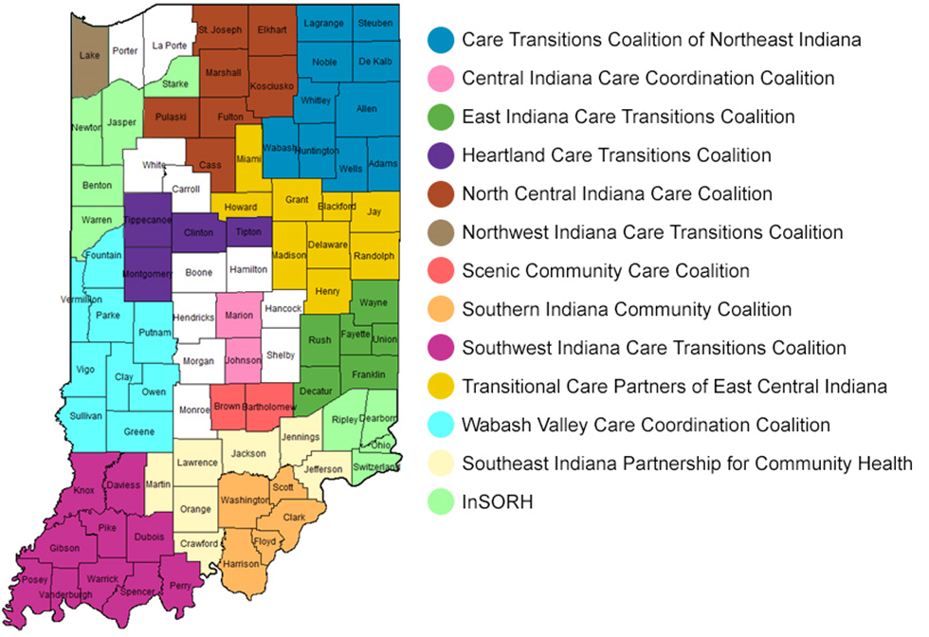
Community Coalitions
Qsource brings together Medicare beneficiaries, providers, and communities together in data-driven initiatives that increase patient safety, make communities healthier, better coordinate post-hospital care, and improve clinical quality.
In addition to improving clinical outcomes, Qsource works with communities to address population health concerns, often referred to as social determinants of health. These include concerns such as insufficient food resources, lack of transportation to follow up appointments, homelessness, among others.

Slide 36
Upcoming Webinars
11/16/23 The Importance of Respiratory Health

Slide 37
Resource Page Updated
Discover What’s New!
We've recently updated our Resources Web page to include Spanish translated materials and new topics.
Download the QR code and keep it handy to access the page on your mobile device. Or visit our Resources Page to view the latest tools, podcasts and on-demand webinars.

Slide 38
Thank You! Visit qio.qsource.org for more info!
This material was prepared by Qsource, a/an Network of Quality Improvement and Innovation Contractors under contract with the Centers for Medicare & Medicaid Services (CMS), an agency of the U.S. Department of Health and Human Services (HHS). Views expressed in this document do not necessarily reflect the official views or policy of CMS or HHS, and any reference to a specific product or entity herein does not constitute endorsement of that product or entity by CMS or HHS. 23.QIO.07.041

